Slide 1
Using Statistical Tools to Identify Poor Behavior or Fraud
Timothy T. Houle, PhD

Slide 2
Our Solution:

Slide 3
StatReviewer Content
Thousands of algorithms are run on every manuscript. We check:
obvious numerical errors
quality of reporting (e.g., defined descriptive statistics)
appropriate statistical tests (e.g., t-test for skewed data)
style (e.g., precision of decimal places)
Methodological reporting

Slide 4
Fraud in Anesthesiology
Scott Reuben, MD (1996 to 2010)
21 fraudulent scientific articles retracted
Admits that he never conducted any of the trials he reported in the literature
Sentenced to prison (2010)
Joachim Boldt, MD (1999 to 2012)
False data in 88 (of 102) scientific articles retracted
Yoshitaka Fujii, MD (1993 to 2012)
172 (of 212) fraudulent scientific articles, with 126 articles entirely fabricated
No ethical oversight, authorship inclusions

Slide 5
Data Fabrication/Falsification
Unethical research behavior
(Conscious or Unconscious)

Slide 6
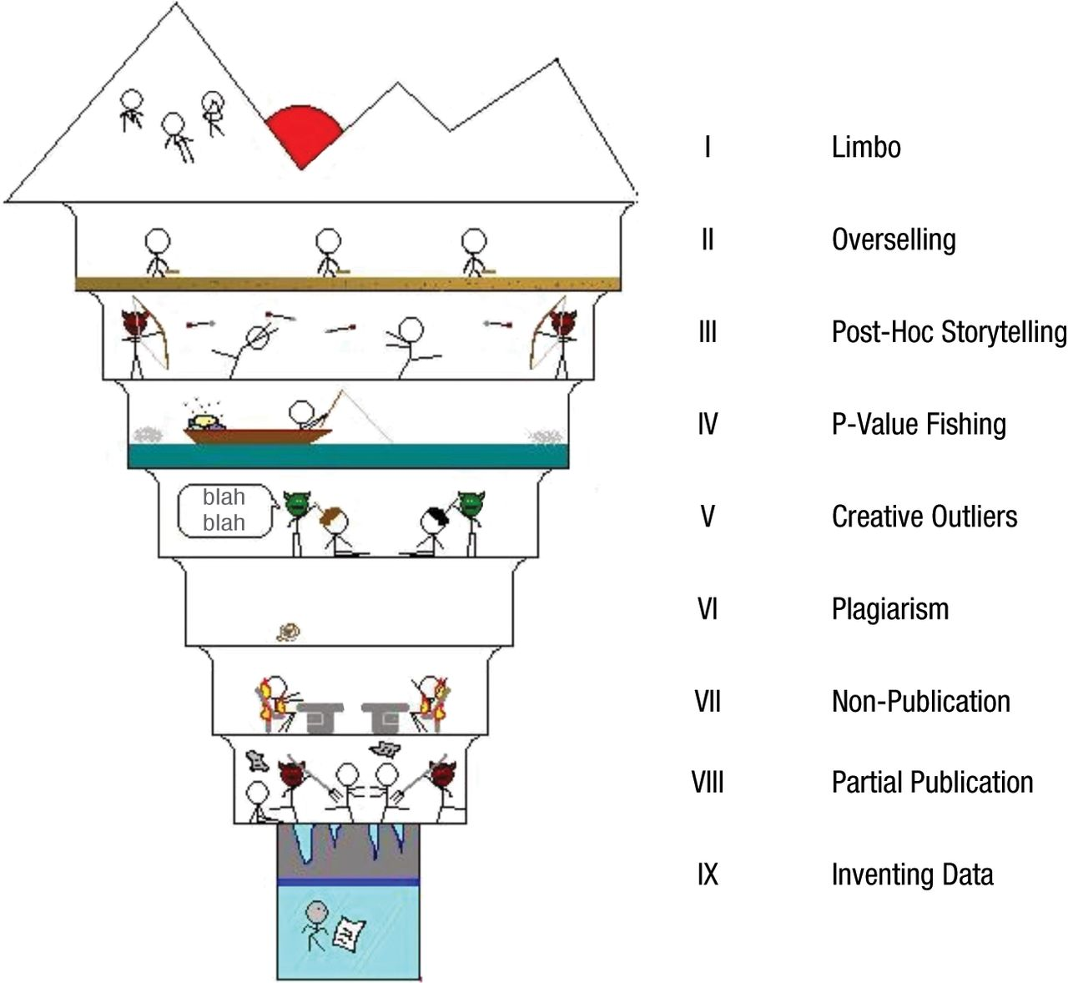
Fig. 1. The nine circles of scientific hell (with apologies to Dante and xkcd).
✔
✔
✔
✔
✔
✔
Neuroskeptic Perspectives on Psychological Science 2012;7:643-644
Copyright © by Association for Psychological Science
Notes:
The nine circles of scientific hell (with apologies to Dante and xkcd)‏

Slide 7
Post hoc Story Telling: Forking Paths
One reasonable hypothesis maps on to several reasonable statistical hypotheses (i.e., one to many)
PONV is associated with age
Statistical interaction (moderation) must be taken into consideration for the primary interpretation
Age x sex is needed to consider the effect of age
Adding confounder control post hoc
We should control for several covariates as they seem to be confounding the age association

Slide 8
A Peculiar Prevalence of P-Values Just Below 0.05: Masicampo & Lalande (2012)
R² = 90%
Number Observed
0.01
0.05
0.10
P-value

Slide 9
Reporting and Interpretation of Randomized Controlled Trials With Statistically Nonsignificant Results for Primary Outcomes
Boutron I, Dutton S, Ravaud P, Altman D. (May, 2010)
Frequency and degree of “Spin” in published RCTs
Spin†: specific reporting that could distort the interpretation of results and mislead readers.
From ignorance of scientific (statistical) issue
Unconscious bias
Willful intent to deceive

Slide 10
Reporting and Interpretation of Randomized Controlled Trials With Statistically Nonsignificant Results for Primary Outcomes
Boutron I, Dutton S, Ravaud P, Altman D. (May, 2010)
Strategies of Spin
A focus on statistically significant results
within-group comparison
secondary outcomes
subgroup analyses
modified population of analyses
Interpreting statistically nonsignificant results for the primary outcomes as showing treatment equivalence or comparable effectiveness
Claiming or emphasizing the beneficial effect of the treatment despite statistically nonsignificant results.
A
B
p = 0.02
p = 0.09

Slide 12
Detecting Fabricated Data in RCTs
J.B. Carlisle (2012)* applied a clever strategy to examine the probability that Fujii’s data were the result of non-random processes
Distribution of patient characteristics “incredibly nice” (Kranke et al, 2000)
Patients in randomized groups too similar to each other
Examined 168 of Fujii RCTs
Compared expected distributions to observed distributions of patient characteristics

Slide 13
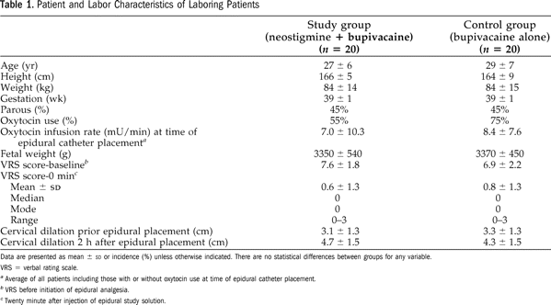
The “Table 1” of an RCT

Slide 14
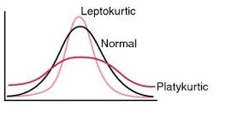
The “Table 1” of an RCT
The standardized difference between
groups should be normally distributed with
A mean of 0.

Slide 15
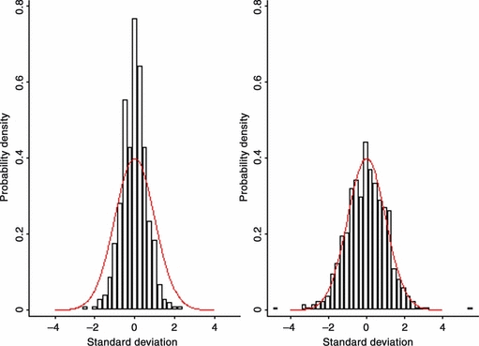
Fujii (left) versus others (right) on Age

Slide 16
Thank You!
info@statreviewer

